Slide 1
Angular for a Single Page Application – Beginnier Guide

Slide 2
Introduction
Angular
  Open Source Framework Designed by Google
  Build interactive, single page application with HTML/Typescript
  Single Page App
    An application which interacts with the user by dynamically rewriting the current page rather than loading entire new pages from the server
  Features of Angular
    Rich Dynamic interactive features
    Two Way Binding
      Changes made from components is automatically reflects in the view and the component
    Modular Based Design
    Interactive Routing – Angular consist of great routing engine loads the page asynchronously
      Page Load – Eager, Lazy Loading, Preloading
    Programming into HTML Pages ex. Loops, Conditional Syntax for render, HTML Content

Slide 3
Installing
Install Dependencies
  NodeJs
  npm
npm install -g @angular/cli // Setup the angular environment
ng new <project name> // Setup an empty angular application
cd into project and ng serve // Run the application server and in the browser – http://localhost:4200

Slide 4
TypeScript
A superset of javaScript and adds optional static typing to the language
Designed for the development of large applications and transcompiles to JavaScripts
  Source to source compile
  Example C++ → C
TypeScript may be used to developer JavaScript applications for both client side and server side execution
Supports Object Orientated Programming, Interfaces, Classes, Enumerated Types, Generics, Modules

Slide 5
Program Structure
.editorConfig – configuration for code editors
README.md – Introductory Information either about angular or your own explanation
angular.json – angular cli default for all projects including build and test tools that the cli uses.
package.json – configures NPM package and dependencies
src – The main src folder the for the application files
  create new modules, services or components
  main.ts – An entry point tio the application and helps to create the browser environment
  app.component.ts
  index.html – Run your app component
node_modules – NPM Packages to the entire workspace
  visible to all project
tsconfig.json – The base typescript configuration
  All config files inherit from this base file

Slide 6
First App
create a folder
npm install -g @angular/cli
  setups the angular environment
ng new <appName>
  Creates an angular project
  Will ask for auto-completion, routing and stylesheet
ng serve to to run the project
  http://localhost:4200

Slide 7
Modules
Module is a group of related components
  Components
  Pipes
  directives
  services
Each Angular app has at least one module
app.module.ts –
  @NgModule is responsible from declarations, imports, providers, bootstrap
    A declaration a module is being worked on
    declarations – Register componennts directives and pipes
    imports – Define other modules
      BrowserModules – responsible fro browser specific renderers : ng for, ng switch, ng if
    providers – Define services that are public
    bootstrap – For root component
      The component the application starts with
Can split root modules into submodules to create more maintainable code
ng generate module <name> which does not contain the providers or bootstrap

Slide 8
BootStrap
Defines the Component that will appear for the default url
Experiment
  Given : Create an Angular project ( ng new ) , Have component called component1
  Edit the index.html project to include app-component1int the body. Example
    <body>
      <app-component1></app-component1>j
    </body>
  ng server and in a browser use http://localhost:4200 – Get a blank page
Experiment
  Given : Create an Angular project ( ng new ) , Have component called component1
  Edit app.component.ts and put Compoent1Component in the bootstrap property list
  Edit the index.html project to include app-component1int the body. Example
  <body>
    <app-component1></app-component1>j
  </body>
  ng server and in a browser use http://localhost:4200 – The page display component1 works

Slide 9
Component
Consist of HTML Template, class and metadata
@Component – Defines a componnet
  selector – How you want to call from main component
  templaetUrl Name of HTML Page or the actual HTML itself
  StyleCss CSS Files
Have the class that is exported
  Used for defining variables/functions to be used with the HTML Function
  In the HTML Page <p>{{name}}</p>

Slide 10
Directive
Building blocks of angular application
3 Types
  Components –
    Components are the template directives
  Structural Directives
    Responsible for conditional / looping,
    Ex. nfIf, NgSwitch, NgFor
  Attribute Directive
    Manipulate the DOM by changing its behavior
    Ex. NgClass, NgStyle

Slide 11
Routing
Navigate from one view page to another
Routing works with library package called @angular/route
In the index.html – < base href=”/”> ( standard routing path )
Add Angular Routing
  Two ways
    ng create app – When queried then select y for angular routing and may need to add a routes array
    Manually
      Create a new module called app-routing.modules that will export AppRoutingMoudle class and routing components array
        Contains the routes array that contains the routes
        import @angular/router for the routing
      In the app.modules.
        add “import { AppRoutingModule, routingComponents } from ./app-routing.module
        Make it part of the declaration

Slide 12
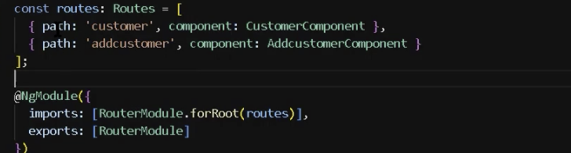
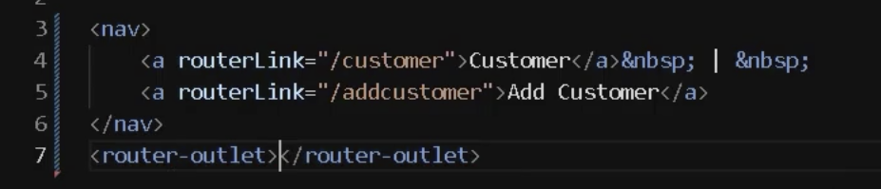
Routing
To add the Routes
  See the picture to the right
Add Menus.
  In the component’s html add the following code to get menus
  router-outlet is needed to make the menus
Remember that <router-outlet> is the placeholder for where the route will put the html that it is assigned.

Slide 13
Forms Modules
Two Types of forms
  Template Driven Forms
    HTML Based
  Reactive Forms
    Built totally on TypeScript
    Get better control than Template Driven Forms
Need the Forms Module ( @angular/forms) and add it to @NgModule imports declaration
Use the html form tag including form, , input tag
  <form (ngSubmit) = “onSave(myform)” #myForm=”ngForm”)
    When the submit button is press the Save onSave Function is called with the variable ngForm ( contains the data from the form)
    Inside the *.components.ts the class should have an onSave Funciton
  <input type=”text” id=”textBox” name=”username” ngModle>
    name is useful for view modeling for textbox
    ngModel – bind textbox information into name properties

Slide 14
Data Binding
One Way Binding
  String Interpolation
    works with the String Data Type
    {{ }}
    Can be used in tags
    Can handle calculations {{ 10 * 9 }}
  Event Binding
    Used to bind an event such as click, mouseover, chain
    Example
      *.component.html
        <input type=”text” [value]=”CustomerName” /.
        <intput type=”button” value=”Add Customer” (click)=”AddCustomer(): />
        <p>{{message}}</p>
      *.component.ts – In *Component implements OnInit
        customerName:string = “John”
        AddCustomer() { this.message = “Customer Added”; }
      CustomerName is being value binding as a property
      message is done with event binding

Slide 15
Data Binding
Two Way Data Binding
  Example
    *.component.html
      <input type=”text” [(NgModel)]=”customerName” // Binds an input, select, textArea to a property on the scope using ngController
      {{CustomerName}}

Slide 16
ngFor, ngIf, ngSwitch, ngClass
ngFor –
  In *component.ts add a customerList
    customers = [
      { customerName: ‘a’, age: ‘23’ },
      { customerName: ‘b’, age: ‘25’ },
      { customerName: ‘c’, age: ‘26’ }
      ]
  In *component.html display
    <tr *ngFor=”let customer for customers”>
      <td>
        {{ customer.customerName }}
      </td>
      <td>
        {{ customer.age }}
      </td>
    </tr>

Slide 17
ngFor, ngIf, ngSwitch, ngClass
ngIf
  Example in *.component.ts
    include two variables isChecked: boolean = false; / isHide = true
    Add function checkClick() { this.isChecked = true; this.isHide = true; }
  Example in *.component.html
    <div *ngIf=”isChecked; else noInterest”>
      Customer is interested
    </div>
    <ng-template #noInterest>
      <div id=”dvNotIntrst” *ngif=”isHide”>
        Customer is not interested
      </div>
    </ng-template>

Slide 18
ngFor, ngIf, ngSwitch, ngClass
ngIf
  Example in *.component.ts
    include two variables isChecked: boolean = false; / isHide = true
    Add function checkClick() { this.isChecked = true; this.isHide = true; }
  Example in *.component.html
    <div *ngIf=”isChecked; else noInterest”>
      Customer is interested
    </div>
    <ng-template #noInterest>
      <div id=”dvNotIntrst” *ngif=”isHide”>
        Customer is not interested
      </div>
    </ng-template>

Slide 19
ngFor, ngIf, ngSwitch, ngClass
ngSwitch – Help to display element based on condition
  In *components.ts
    add countries:string=””
  In *components.html
    div class=”card-body>
    <div [ngSwitch]=”countries”>
      <div *ngSwitchCase=”’In’”>India</div>
      <div *ngSwitchCase=”’US’”>United States</div>
      <div *ngSwitchDefault>This country code is not in the memory.</div>
    </div> Stopat at 7:49

